Slide 1

Cyclistic Case Study
Analyst: Kevin W.
Jan 2023

Slide 2
Questions
How do annual and casual members use Cyclistic bikes differently?
Can we convert casual riders into annual ones in order to increase revenue?

Slide 3
The Data
The data is public and has been made available by Motivate International Inc. through Coursera under this license.
I used the most recent data containing all the months in 2022 for this analysis. Rstudio and Excel were used in both the data cleaning and analysis.
For more details on the data cleaning and analysis, see attached “Coursera Case Study” document.

Slide 4
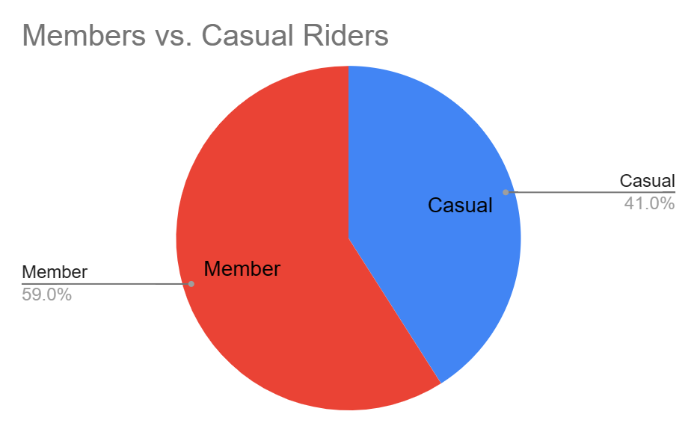
Our Customers

Slide 5
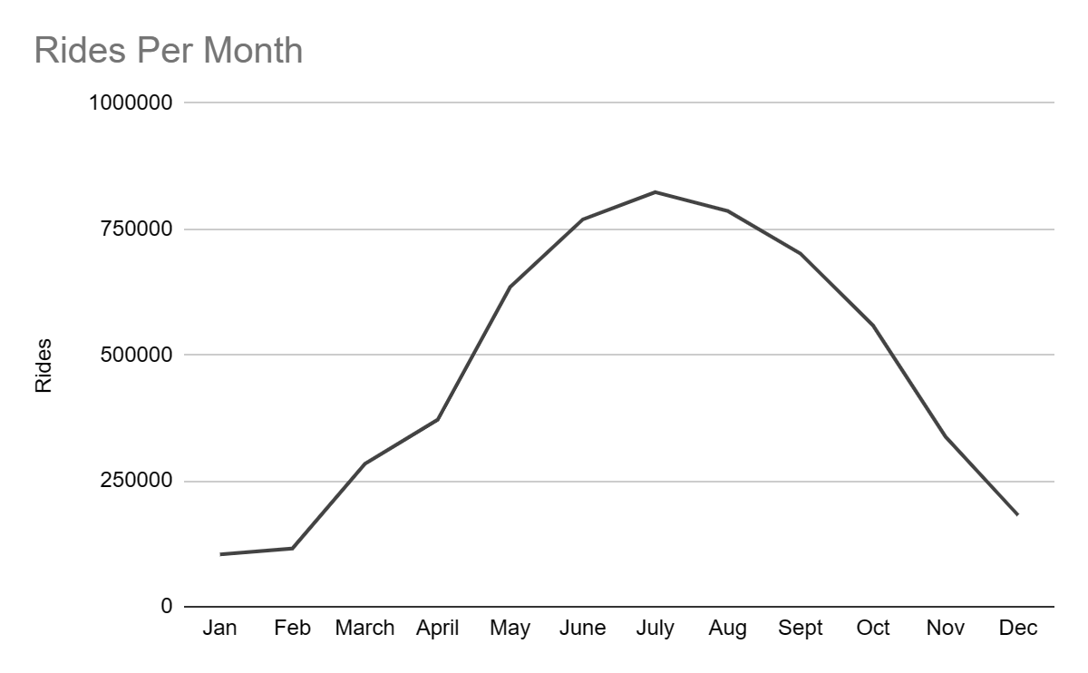
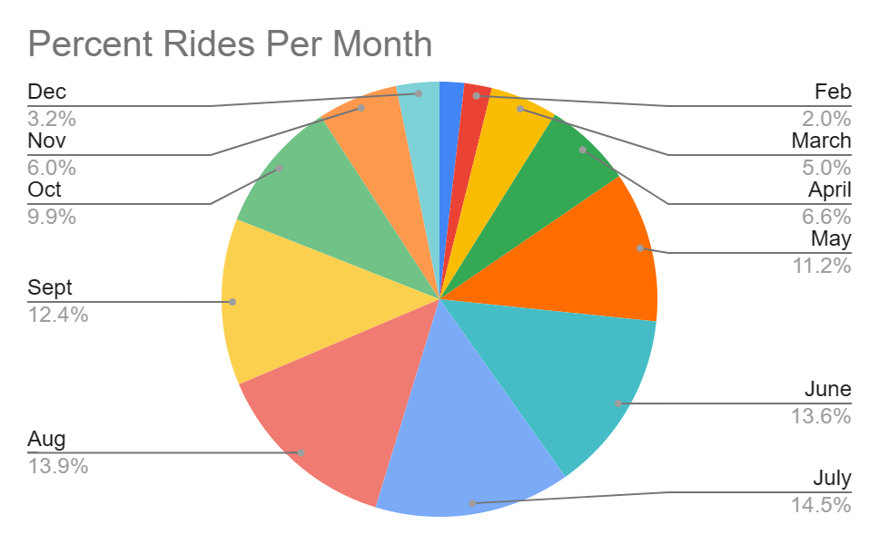
Which are the Popular Months?

Slide 6
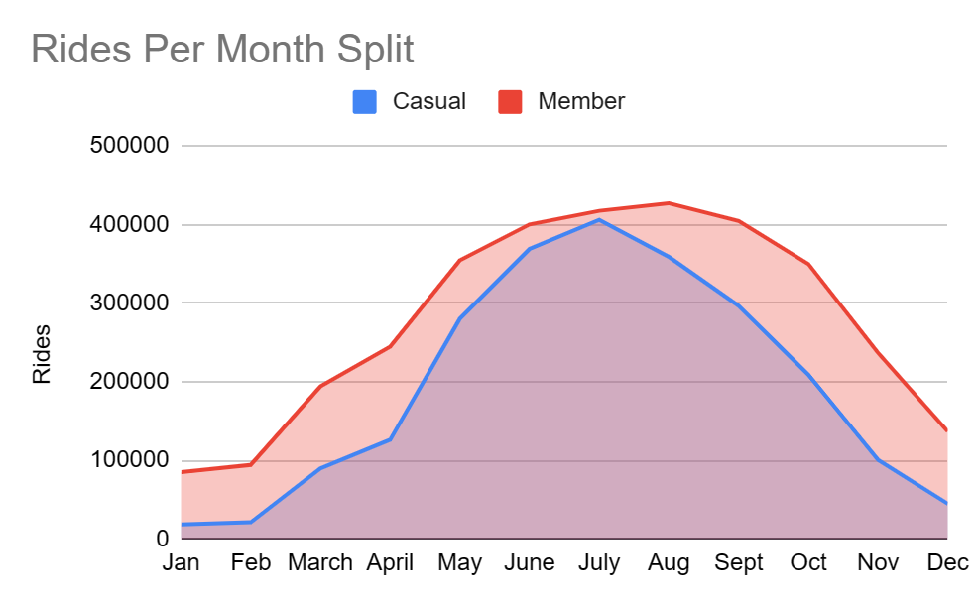
Split Between Members and Casual Riders
Sharper increase in casual riders as compared to members going from April into the summer months.
Targeting the summer months will be crucial for increasing revenue.

Slide 7
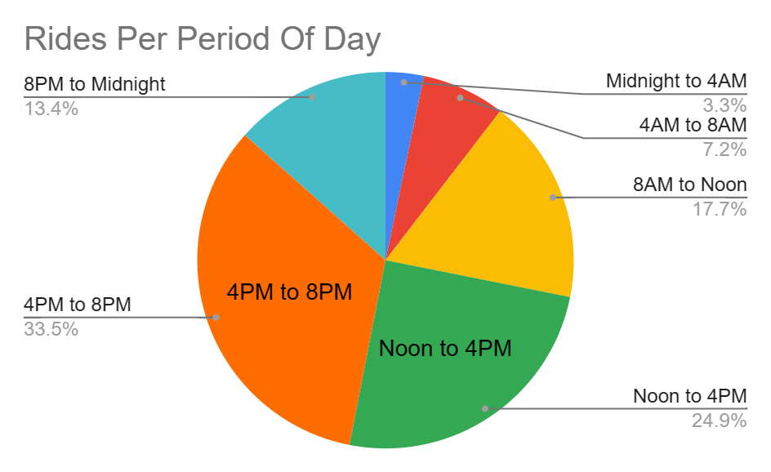
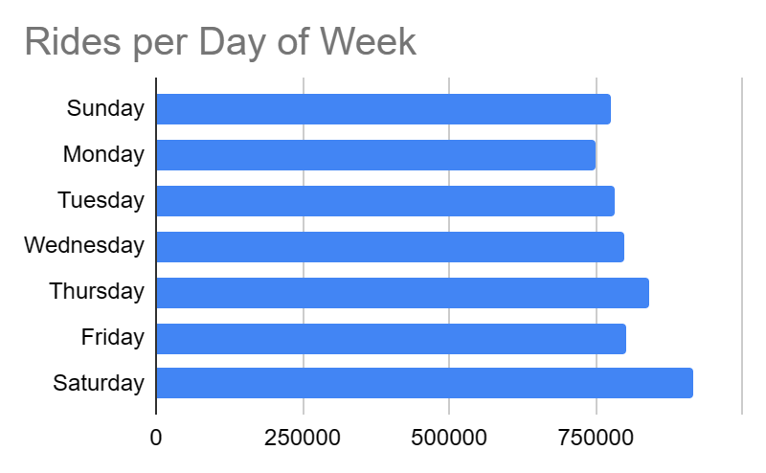
When do People Ride?
4PM - 6PM is the busiest 3 hour time slot.

Slide 8
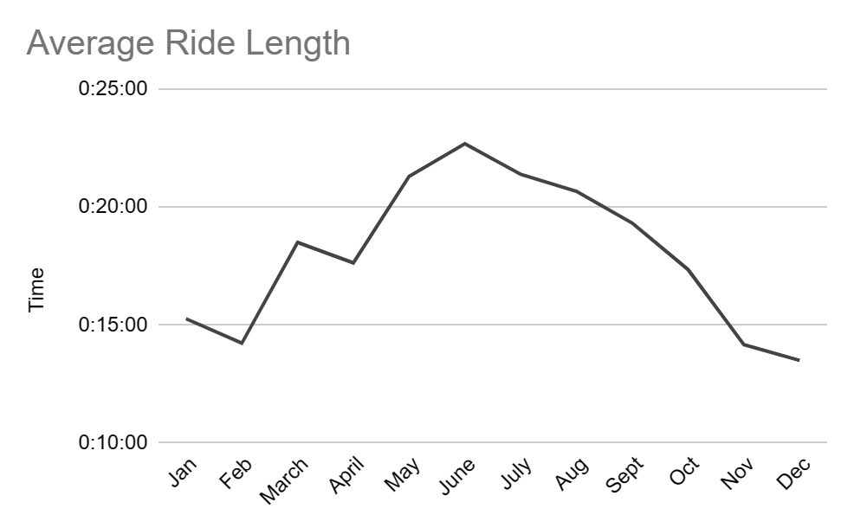
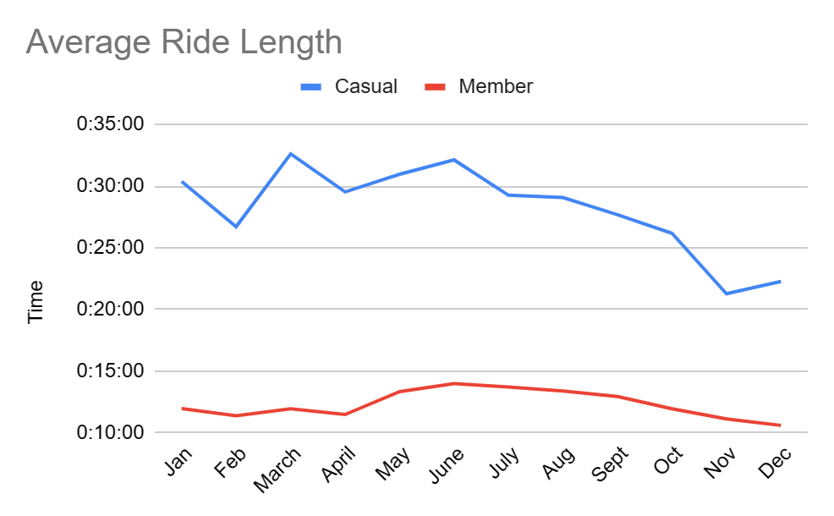
How Long do People Ride?

Slide 9
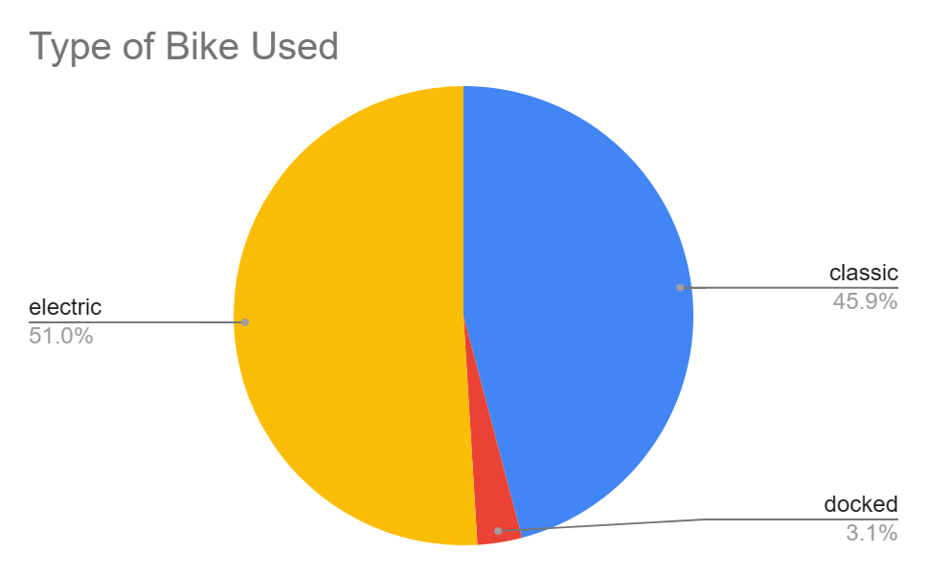
What Kind of Bike do our Riders Prefer?
Electric bikes are the most popular, followed closely by classic bikes at 6% less.

Slide 10
Key Takeaways
Casual customers ride longer than members on average.
Casual and annual members ride more and longer during the summer months.
Saturday is the most common day to ride and 4PM to 6PM is typically the busiest time slot.
Preferences between electric and classic bikes are too close to make any discernible differences.

Slide 11
Suggestions
Create a summer promotion for casual riders, targeting June through August, the three most popular months.
Remind casual riders (either in-app, through email, or on the bike stations) that they can convert to an annual membership if they ride regularly, such as for work.
Offer exclusive weekend or 4PM to 6PM perks for annual members and promote this to casual riders who may want to convert.

